Slide 1
The Water Cycle
A presentation by Science Doodles

Slide 2
Vocabulary Words
Water cycle
Precipitation
Condensation
Evaporation
Transpiration
Run-off

Slide 3
Water cycle

Slide 4
Precipitation

Slide 5
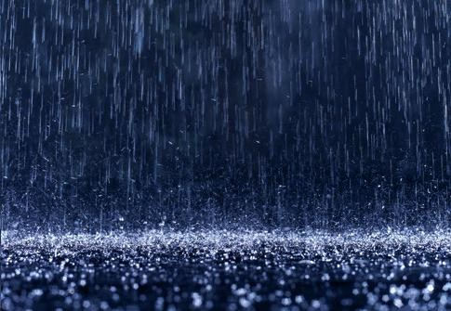

Slide 6
Condensation

Slide 7
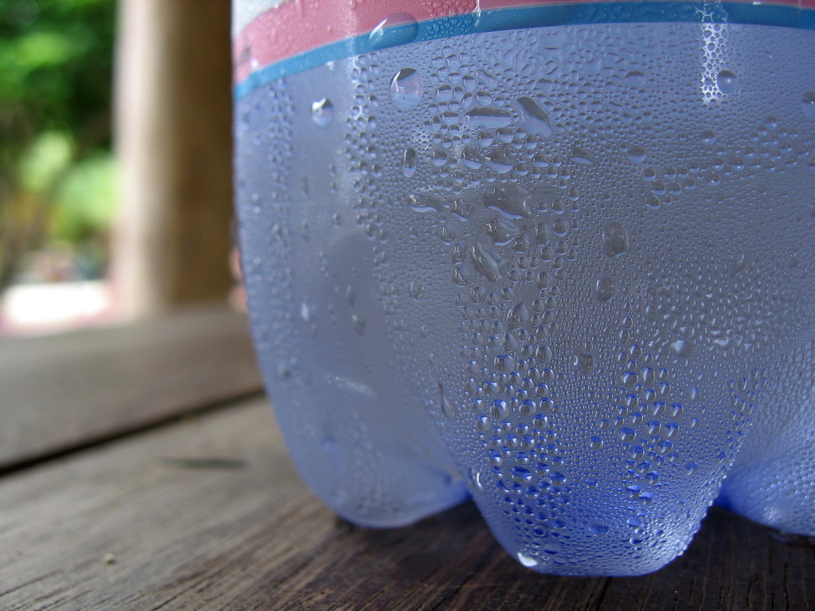

Slide 8
Evaporation

Slide 9
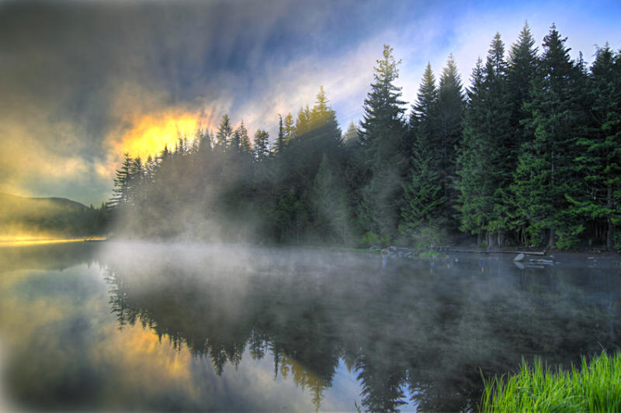

Slide 10
Transpiration

Slide 11
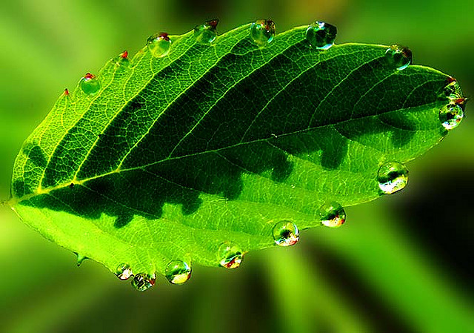

Slide 12
Run-off

Slide 13
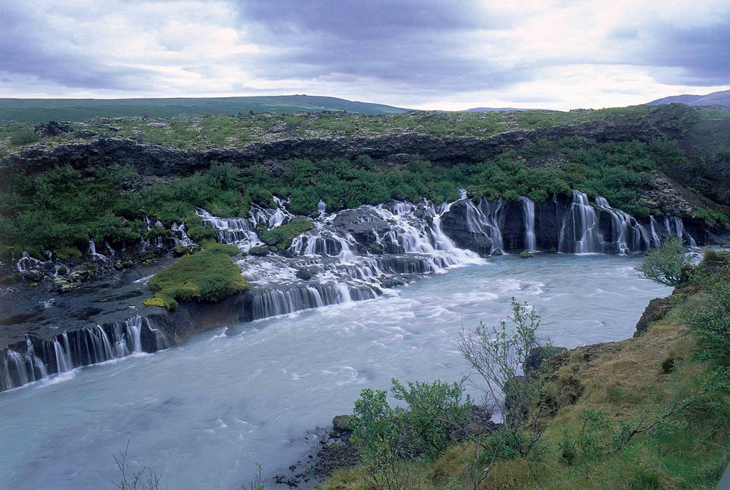

Slide 14
Quiz

Slide 15
What is the process that occurs when water changes from a liquid to a gas, caused by heat?

Slide 16
What are water droplets that fall from the atmosphere in the form of rain, sleet, snow, or hail?

Slide 17
What is the passage of water vapor from a plant to the atmosphere?

Slide 18
What is rainfall that is not absorbed by soil and travels to the ocean?

Slide 19
What is the cooling of water in the atmosphere changing gas to a liquid?

Slide 20
What are the changes to water when it evaporates into the air, condenses into clouds, and then precipitates down to Earth?

